Slide 1
Customer Personality Analysis by Generation Dan H
https://www.kaggle.com/datasets/imakash3011/customer-personality-analysis

Slide 2
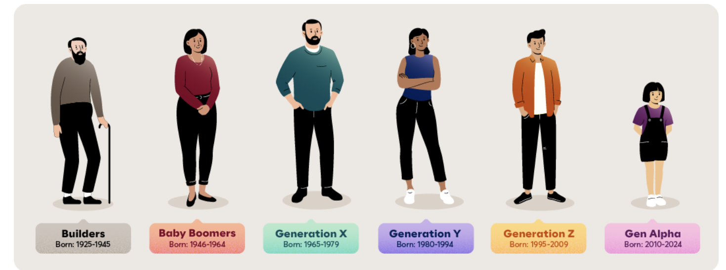
Original statements : Customer Personality Analysis is a detailed analysis of a company’s ideal customers. It helps a business to better understand its customers and makes it easier for them to modify products according to the specific needs, behaviours and concerns of different types of customers.
Dan Question : Is there any behavior change between generation when receiving the marketing offer?

Slide 3
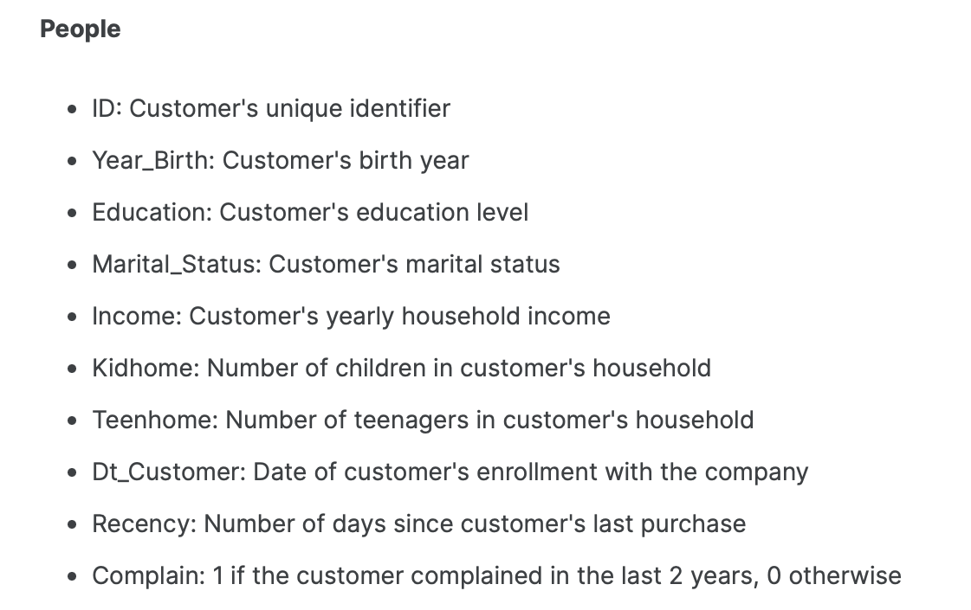
No of respondant : 2240 person with 29 columns

Slide 4
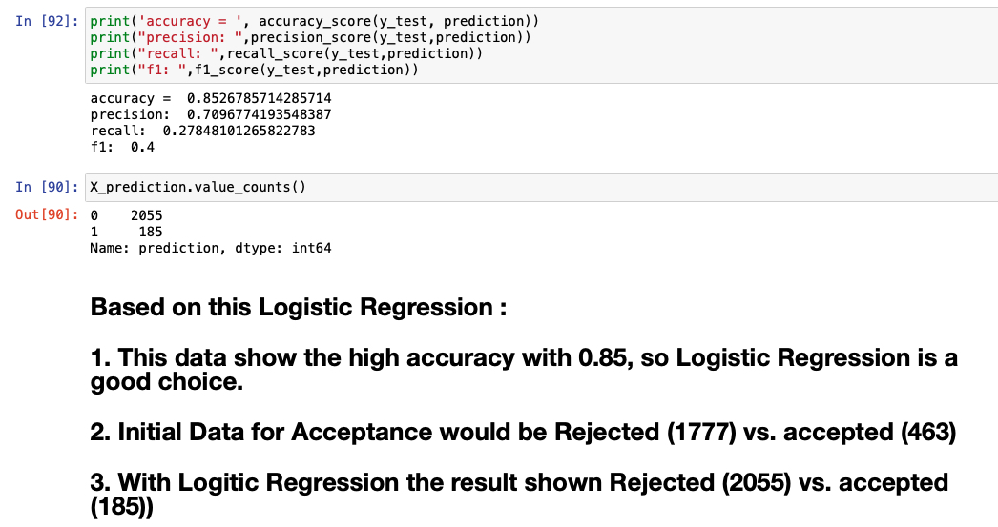
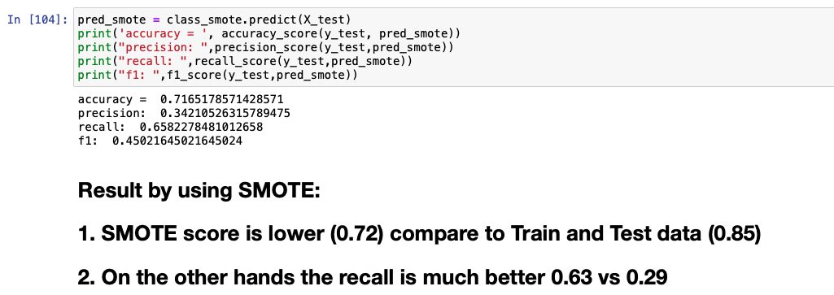

Slide 5
Info | Logistic Regression | SMOTE Regression
Accuracy | 0.85 | 0.71
Precision | 0.71 | 0.34
Recall | 0.28 | 0.66
F1 – Test Prediction | 0.40 | 0.45

Slide 6


